Slide 1
COM-I ( Introduction to Business)
Dr. Sumita Shankar

Slide 2

Introduction to Business

Slide 3

MODULE -1

Slide 4
INTRODUCTION TO BUSINESS
What is Business ?

Slide 5
Definition
B.O. Wheelar, “Business is an institution organised and operated to provide goods and services to society under the incentive of private gain.”

Slide 6
Definition
L.H. Haney, “Business is a human activity directed towards producing or acquiring wealth through buying and selling activities.”

Slide 7
Definition
Business is an organized activity to identify , anticipate, and to produce and supply customer requirement efficiently and profitably of all those who are connected with it ”

Slide 8

NATURE OF BUSINESS or FEATURES OF BUSINESS
1) ORGANISED ACTIVITY

Slide 9

NATURE OF BUSINESS or FEATURES OF BUSINESS
2) Profit Motive

Slide 10
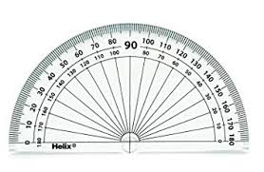
NATURE OF BUSINESS or FEATURES OF BUSINESS
3) Degree of Scale

Slide 11

NATURE OF BUSINESS or FEATURES OF BUSINESS
4) Regularity in Dealings

Slide 12

NATURE OF BUSINESS or FEATURES OF BUSINESS
5) Risks and Uncertainities

Slide 13

NATURE OF BUSINESS or FEATURES OF BUSINESS
6) Societal Interest

Slide 14

NATURE OF BUSINESS or FEATURES OF BUSINESS
7) Social Responsibility

Slide 15
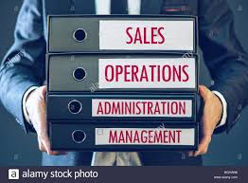
NATURE OF BUSINESS or FEATURES OF BUSINESS
8) Business Functions

Slide 16

NATURE OF BUSINESS or FEATURES OF BUSINESS
9) Customer Satisfaction

Slide 17


NATURE OF BUSINESS or FEATURES OF BUSINESS
10) Creative and Dynamic

Slide 18

NATURE OF BUSINESS or FEATURES OF BUSINESS
11) Government Control `

Slide 19


